Slide 1



Resilience
Part of the DNA of Care Programme

Slide 2
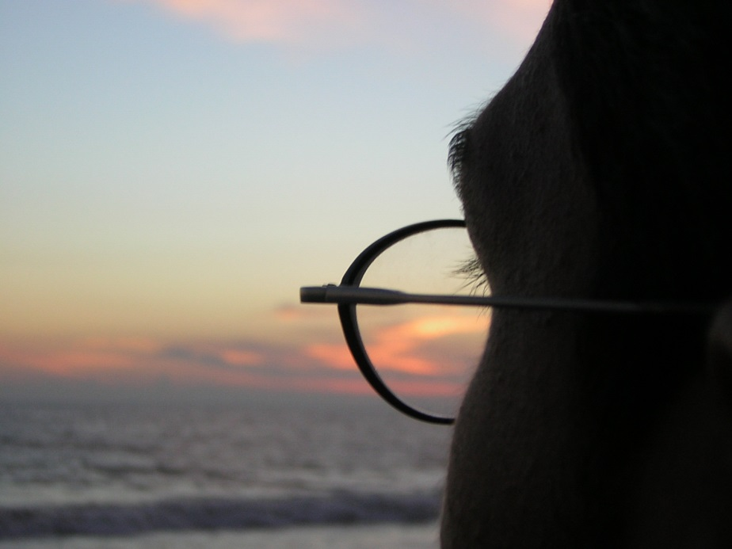
Overcoming adversity
‘Every great personal story you have to tell involves overcoming adversity.
If you shy away from adversity, you take away your ability to tell new stories.’
Farrell Drake

Slide 3

Resilience - with it
swift recovery from difficulty or adversity
strategies for managing pressure and stress
a positive outlook
sense of wellbeing
empathy and compassion
sometimes it’s ok not to
be ok
Photo © Pip Hardy

Slide 4
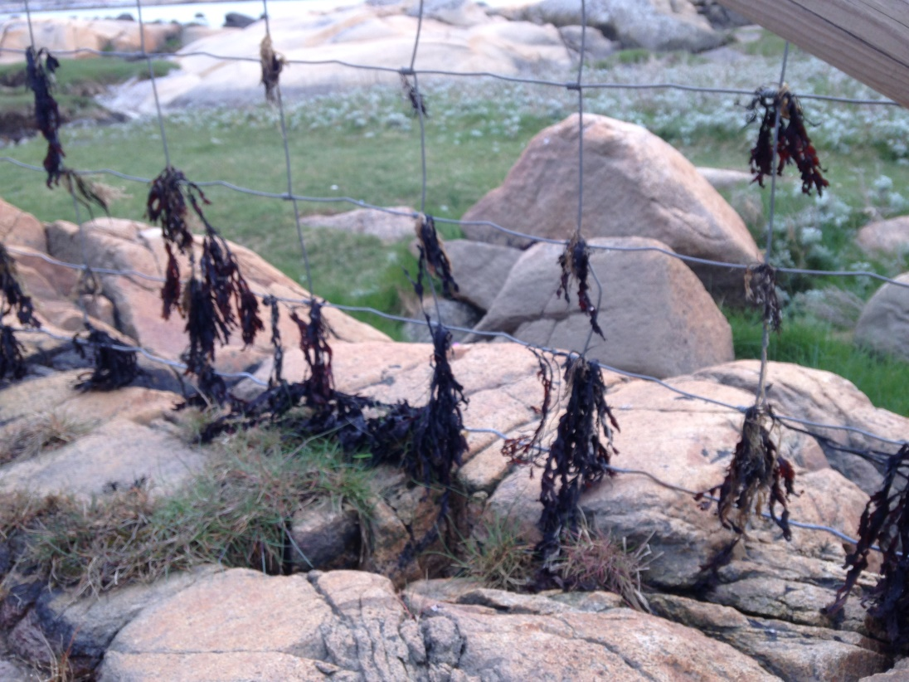
Resilience – without it
exhaustion
sickness
burnout
feeling overwhelmed
feeling worthless
Photo © Pip Hardy

Slide 5

Resilient people…
manage negative emotions
assert influence while accepting external controls
learn from past experience
seek and use supportive environmental factors
practise the use of protective factors
engage with others for own support and development
Photo © Pip Hardy

Slide 6
Resilient organisations foster….
alertness to risks
a realistic, compassionate and open team culture
regular managed timeouts to discuss problems and work/life balance
shared responsibility to act on stressors and risks
acceptance of responsibility for acting on difficulties
culture of support, safety and confidentiality
external networks, partnerships and strategies
mindfulness training
team CPD
ensuring staff are registered with a GP.

Slide 7

The problem with resilience
Recovering from adversity –
whose responsibility is it?
Resilience – a badge of honour?
‘It’s ok not to be ok’
Photo © Pip Hardy

Slide 8
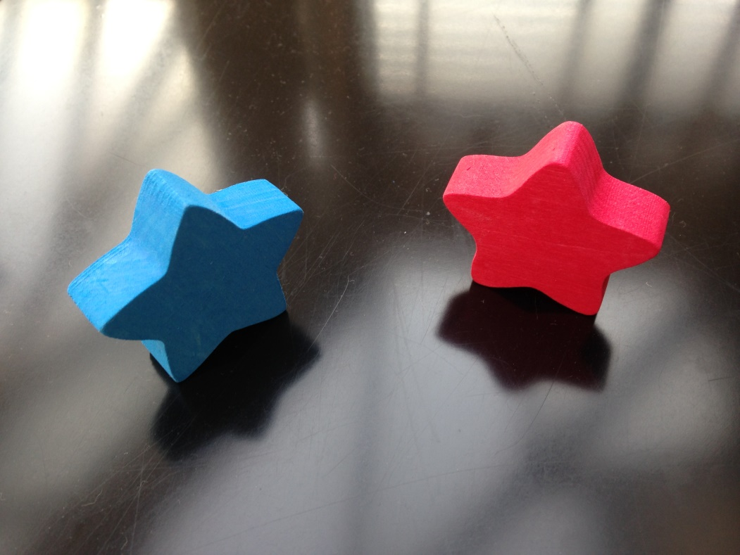
A resilient system
‘A resilient system is what we need: one that adequately recruits, retains, values and supports its employees.’
Oliver 2017
Photo © Pip Hardy

Slide 9

The DNA of Care
‘The intertwined relationship between patient care and staff well-being has been likened to the double helix. And so the stories we tell each other are like the DNA of care, transmitting information and shaping cultures, offering learning opportunities and, sometimes, healing.’
Pip Hardy and Tony Sumner, 2016

Slide 10
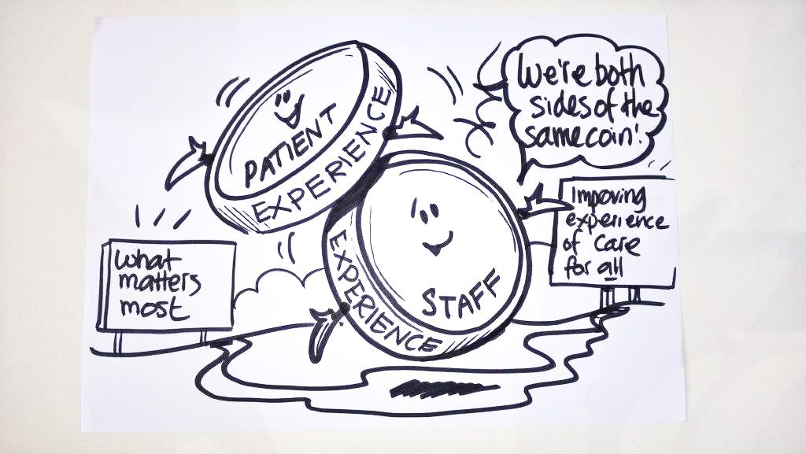
Two sides of the same coin
Staff experience drives patient experience.
‘Focusing on this relationship could be the most important move for the healthcare system to make.’
Karen Deeny, 2017

Slide 11
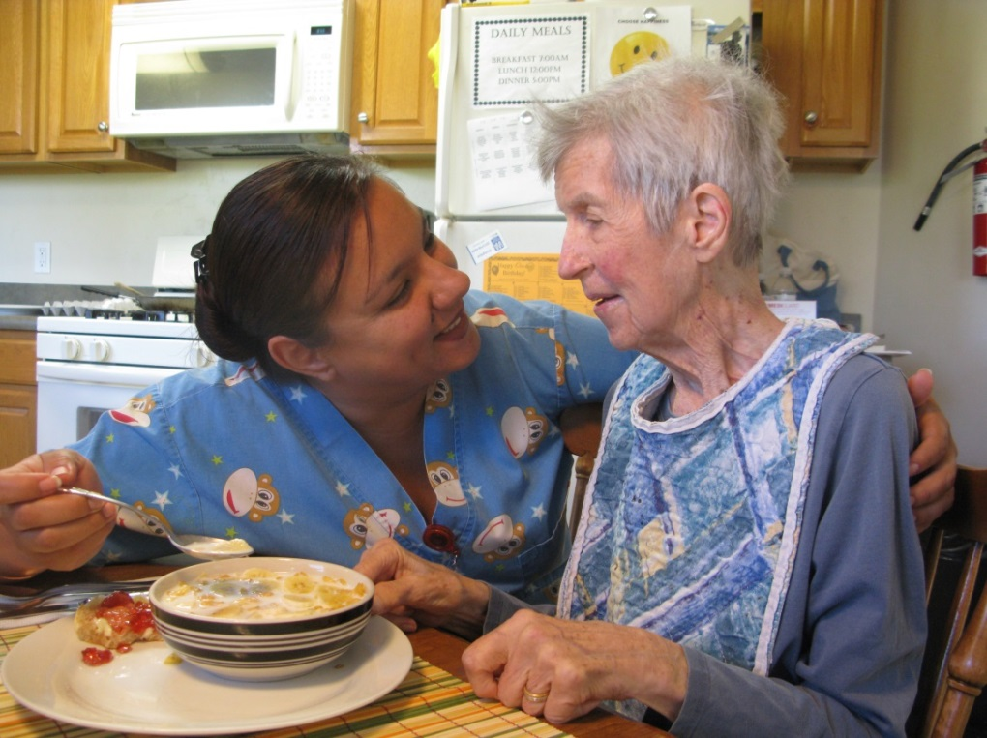
Compassion for everyone
‘Both staff and patients need care, compassion and respect.’
Professor Michael West 2014
Photo © Pip Hardy

Slide 12
DNA of Care stories of resilience
Dis-integration
What do you see?
Stay
Floristry, perhaps?
Impermanence
I’m sorry
Forgotten to remember
Now I know health?
Red shoes
The moonlight world
Tears
Stickers
Take my hand and we will grow
You can do this!

Slide 13
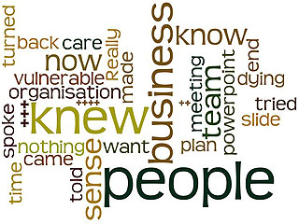
Dis-integration
www.patientvoices.org.uk/flv/1016pv384s.htm Rebecca Walker 2016

Slide 14
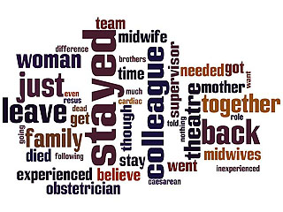
Stay
www.patientvoices.org.uk/flv/1019pv384s.htm Rachel Scanlan 2016

Slide 15
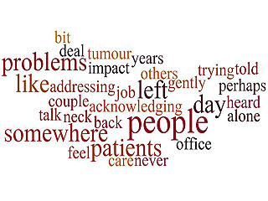
Floristry, perhaps?
www.patientvoices.org.uk/flv/1018pv384s.htm Lizz Summers 2016

Slide 16
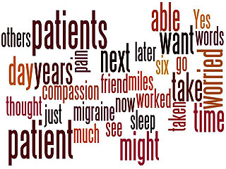
Impermanence
www.patientvoices.org.uk/flv/1028pv384s.htm Natasha Curran 2016

Slide 17
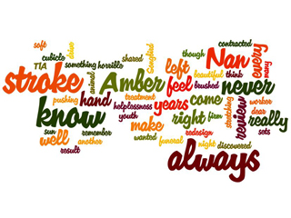
I’m sorry
www.patientvoices.org.uk/flv/0999pv384s.htm Sharon Knight 2016

Slide 18
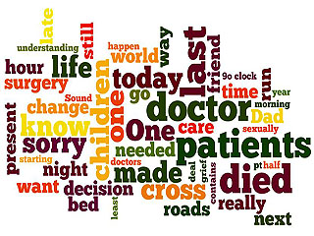
Forgotten to remember
www.patientvoices.org.uk/flv/1005pv384s.htm Ruth Bromley 2016

Slide 19
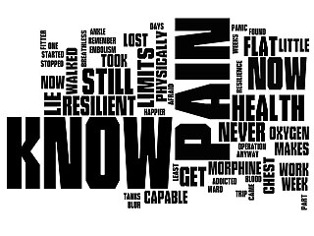
Now I know health?
www.patientvoices.org.uk/flv/1004pv384s.htm Nick Harland 2016

Slide 20
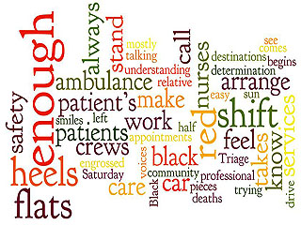
Red shoes
www.patientvoices.org.uk/flv/1001pv384s.htm Amira Chaudhry 2016

Slide 21
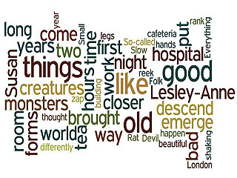
The moonlight world
www.patientvoices.org.uk/flv/1007pv384s.htm David Gilbert 2016

Slide 22
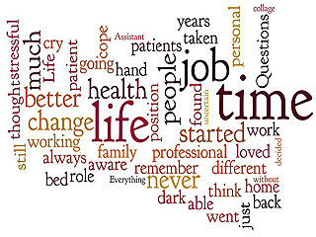
Tears
www.patientvoices.org.uk/flv/1008pv384s.htm David Charlton 2016

Slide 23
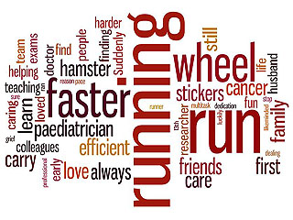
Stickers
www.patientvoices.org.uk/flv/1003pv384s.htm Claudia Gore 2016

Slide 24
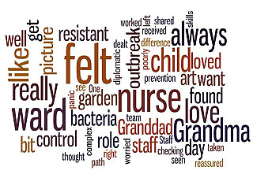
Take my hand and we will grow
www.patientvoices.org.uk/flv/1014pv384s.htm Emma Davies 2016

Slide 25

You can do this!
www.patientvoices.org.uk/flv/0996pv384s.htm Elaine Brand 2016

Slide 26
Questions for reflection
In what ways do these stories connect personal resilience with workplace performance?
In what ways do the stories help to create a compelling focus on the need to address resilience?
What key messages do the stories illustrate with regard to organisational resilience and how this impacts on personal or individual resilience?
How does this story highlight great adversity and the responsibility of the individual to demonstrate resilience?

Slide 27
Questions for reflection
How can sharing stories in this way help us develop cultures where it’s ok not to be ok?
What three things does xx story focus your attention on, in terms of what you (or we) should do next?
Having seen xx story, what is the one thing you feel compelled to do immediately?

